Slide 1
2017 CNL_ICL Customers CRD Summary Report
Adhesive Section Only
Prepared by:
Harry Yu, SA Moy, Jagadeesh, Dan Burkholder

Slide 2
Objectives
Share Findings from CMEE Mobile Industry Data Collection (CNL/ICL platform customer survey)
    Summarize data collected from the Mobile Customers manufacturers:
      Inventec CQ
      Compal CQ
      Quanta CQ/SH
      LCFC
      Compal KS
      MSFT/JDM1
      Pegatron SZ
      Wistron KS
      MSI KS
      Pegatron CQ (ICL ORS)
      Foxconn WH (ICL ORS)
      Huaqin (ICL ORS)
ORS=ODM Reference System

Slide 3
Adhesive

Slide 4
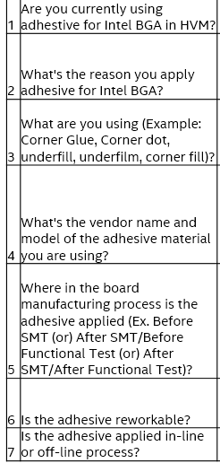
Adhesive on Intel BGA
Adhesive questions that were recently asked during Cannon Lake Platform Introduction:
Previously we had not been asking customers about adhesive usage

Slide 5
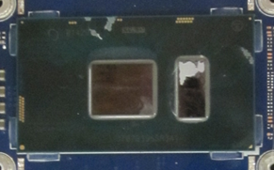
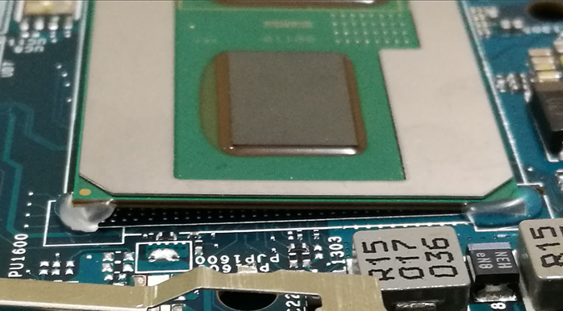
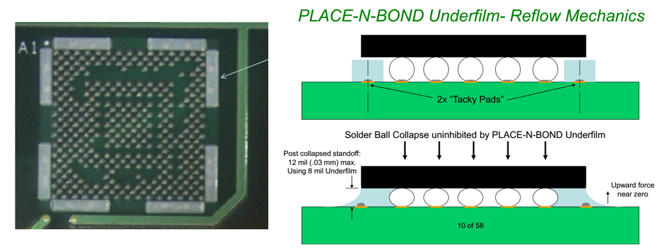
Adhesive on Intel BGA
Corner “L-Shaped” Adhesive
Corner Dot (Big or Small) Adhesive
Pre-SMT Underfilm - Concept

Slide 6
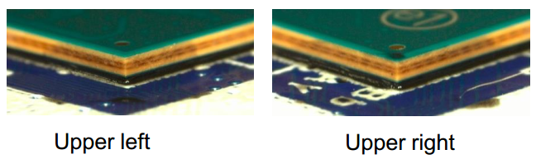
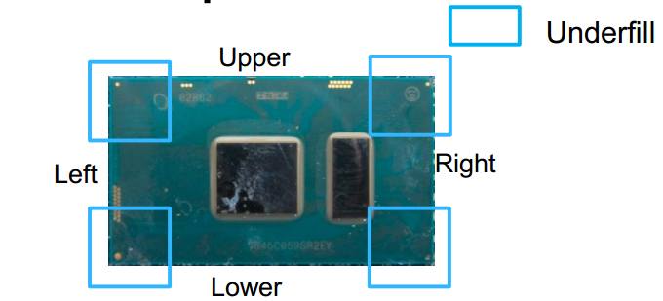
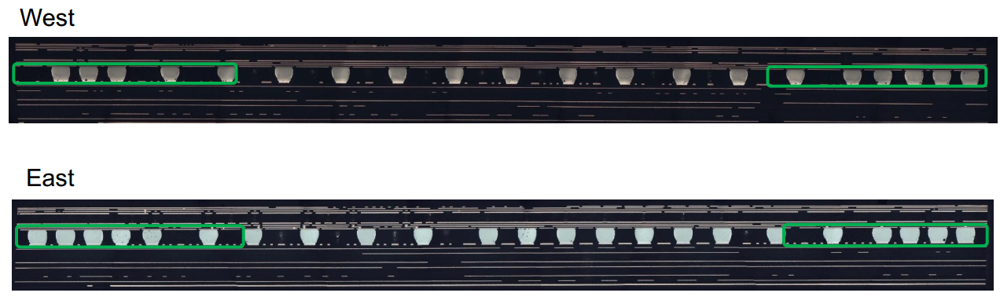
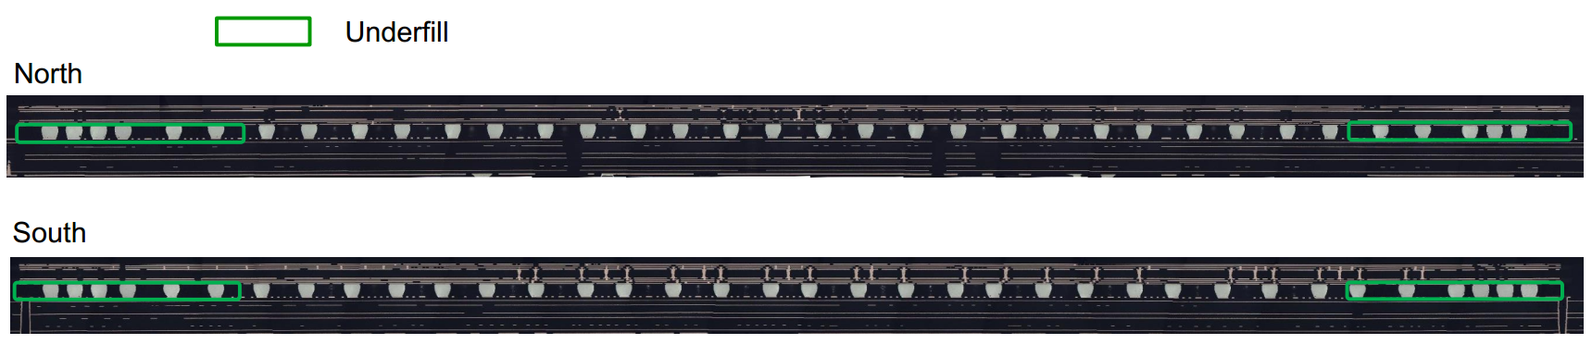
Adhesive on Intel BGA
Corner Underfill (Lenovo Confidential)

Slide 7
Adhesive on Intel BGA (Focused on Laptop & 2-in-1 Manufacturing)
Customer | Y/N | Adhesive shape/location | Vendor name/Model# | Where applied in Factory | Rework-able? | On/Off line
Inventec CQ | Yes | Corner ‘L’ | Loctite 3619 | Before FT | Yes | On line
Quanta CQ | Yes | Corner ‘L’ | Loctite 3609 | Before FT | Yes | On line
Quanta SH | Yes | Corner ‘L’ | Loctite 3609, EICT (UV) | Before ICT | Yes | On line
Compal CQ | Yes | Corner ‘L’ | U-BOND UB-4305 (UV) | Before ICT | Yes | On line
Compal KS | Yes | Corner ‘L’, Corner Underfill (Lenovo) | Corner ‘L’: Loctite 3705 (UV) C Underfill: Likely Loctite 3910 | Corner ‘L’: Before FT C Underfill: After ICT | Yes Hard | On line
Wistron KS | Yes | Corner Dot, Corner Underfill (Lenovo) | Corner Dot: Panasonic ADE480D-1 C Underfill: ASEC-AS3910 | Corner Dot: Before SMT C Underfill: Before FT | Yes Hard | On line
LCFC | Yes | 100% Corner Underfill (Lenovo) | C Underfill: ACES, COOTEK, TaiLiDe | After FT | Yes Hard | On line
Pegatron SZ | Yes | Corner ‘L’ | 視域:UV649/信友:3329/DYMAX 9-20558/Loctite 3705 (All UV) | Before FT | Yes | On line
MSFT/JDM1 | No
MSI KS | Yes | Corner ‘L’ | ZhongYu ZY-303 (UV) | Before ICT | Yes | On line
Pegatron CQ | Yes | Corner ‘L’ | Xin You UV3329 (UV) | Before FT | Yes | On line
Foxconn WH | Yes | Corner Glue | Loctite 3705 (UV) | After SMT | Yes | On line
Samsung* | Yes | Underfilm | Unknown. Placed by PnP machine onto bd pads. | Before SMT | Unknown | On line
All major customers applying adhesive on Intel BGA except MSFT (adhesive decision is based on the reliability test results-to prevent SJ cracks)
All major customers are applying adhesive after SMT but before FT test (to prevent SJ crack during FT test), except with the underfill process (it is hard to rework)
Lenovo’s corner underfill covers a minimum of 5 solderballs in all 4 corners
UV glue is more popular than thermal glue, due to less factory floor space & easy to cure
*We know Samsung uses underfilm but CMEE team did not visit them
Top DT customers (Gigabyte & MSI) seldom add adhesive on Intel PCH (one exception: Asustek)

Slide 8
Adhesive on Intel BGA
Additional Adhesive Info per Jagadeesh
I had looked at teardowns of Intel and non-Intel based tablets (back when we were still focused on Tablets). At that time, I noticed that all SoCs (Intel and non-Intel) had corner glue or underfill. So, I would safely say adhesives are common in laptop / 2-in-1 / tablets / cellphones (cell phones tend to have full underfill), and adhesives are less prevalent in DT and servers.
Additional Adhesive Info per SA Moy
For tablets, I think it is much more sensitive on mobility (drop test performance). Moreover, if our future is also focusing on LTS process, solder joint protection with using adhesive is key. In this case, we also need to remind package platform guys that to consider keep out zone for adhesive (corner glue). FYI…. During LTS sharing, a customer even asking us what type of adhesive that Intel recommended.

